Slide 1
Shoulder Joint Complex
Consists of four basic articulations-
Glenohumeral joint.
Acromioclavicular joint.
Sternoclavicular joint.
Scapulothoracic articulation.

Slide 2
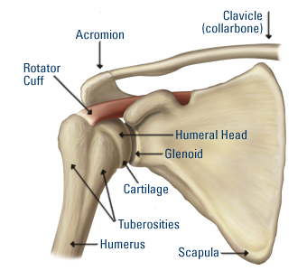
Shoulder Joint

Slide 3
Type of Joint
Synovial joint –
•Ball-and-socket type of joint.
• Multiaxial
• Simple
•Typical

Slide 4
Articular surfaces
Between larger spheroidal head of humerus and shallow glenoid cavity of scapula.
Articular surface covered by hyaline articular cartilage.
Glenoid cavity is deepened by glenoid labrum (fibrocartilaginous rim).

Slide 5
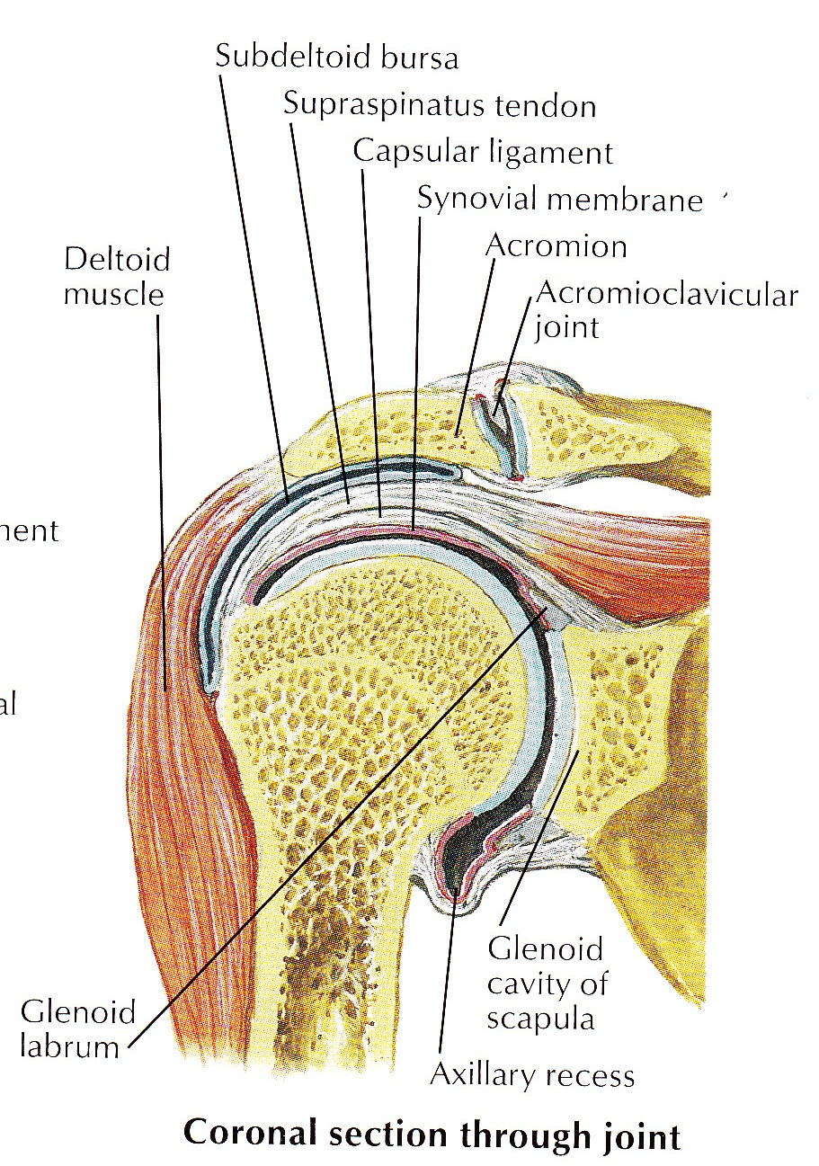

Slide 6
Ligaments
Capsular ligament
Surrounds joint and attached :
Medially to the scapula beyond the supraglenoid tubercle and the margins of the labrum.
Laterally to the anatomical neck of humerus,except inferiorly where it extends 1.5 cms below on to the surgical neck of humerus.
Thin and lax, allow wide range of movement.

Slide 7
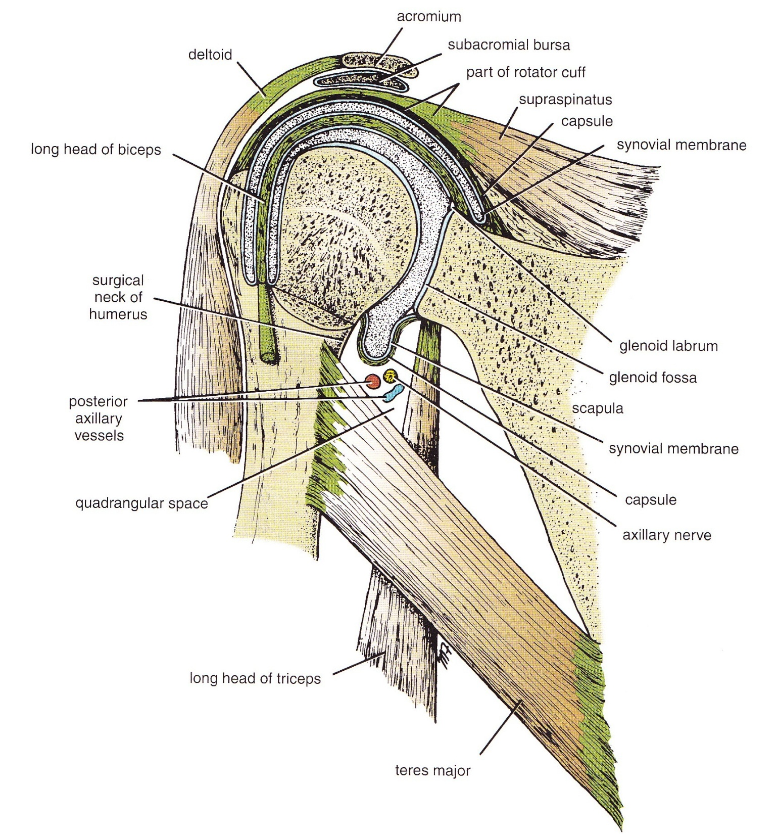

Slide 8
Synovial Membrane
Lines capsule and is attached to the margins of the cartilage covering the articular surface.
Communicates with subscapular and infraspinatus bursae around the joint
Forms tubular sheath around the tendon of the long head of biceps brachii.

Slide 9
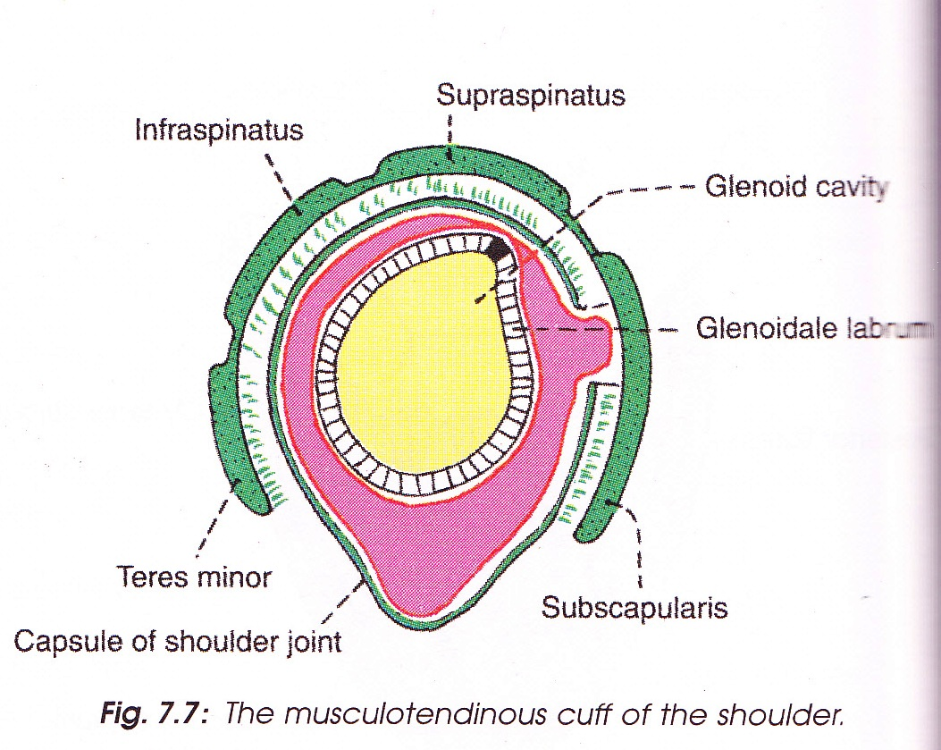

Slide 10
Ligaments (contd.)
Glenohumeral Ligament
3 weak bands (superior, middle & inferior) of fibrous tissue that strengthen the anterior
of capsule.
2. Transverse humeral Ligament
Bridges the upper part of bicipital groove of humerus (between greater and lesser tubercles).Tendon of long head biceps brachii passes deep to it.
3. Coracohumeral Ligament
Strecthes from base of the coracoid process of scapula to greater tubercle of humerus.

Slide 11
Accessory Ligaments
Coracoacromial Ligament
Extends between coracoid process of scapula and acromion.
Protects the superior aspect of joint.
Coracoacromial Arch
- Formed by coracoid process,acromian process and coracoacromial ligament in between.
- Protective arch for head of humerus from above.

Slide 12
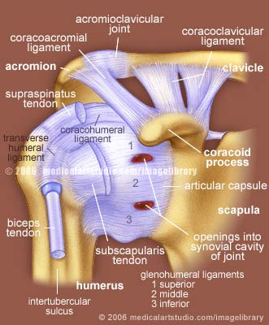

Slide 13
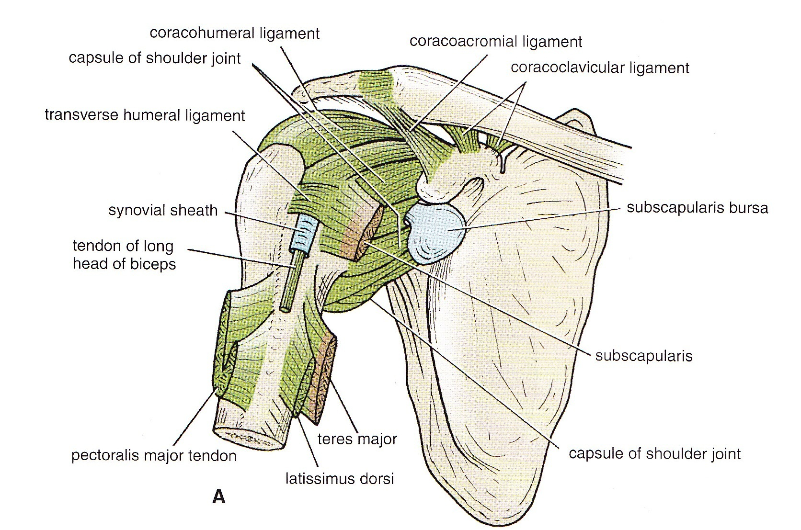

Slide 14
Bursae Related To The Joint
Subacromial (Subdeltoid) bursa
lies between coracoacromial ligament &acromian process above, and supraspinatus & joint capsule below.
-Largest bursa of body
Subscapularis bursa
between tendon of subscapularis and neck of scapula.
Infraspinatus bursa
-between tendon of supraspinatus and posterolateral aspect of joint capsule.
The bursae around the joint communicate with the cavity of
joint
Opening of bursa means opening joint cavity.

Slide 15
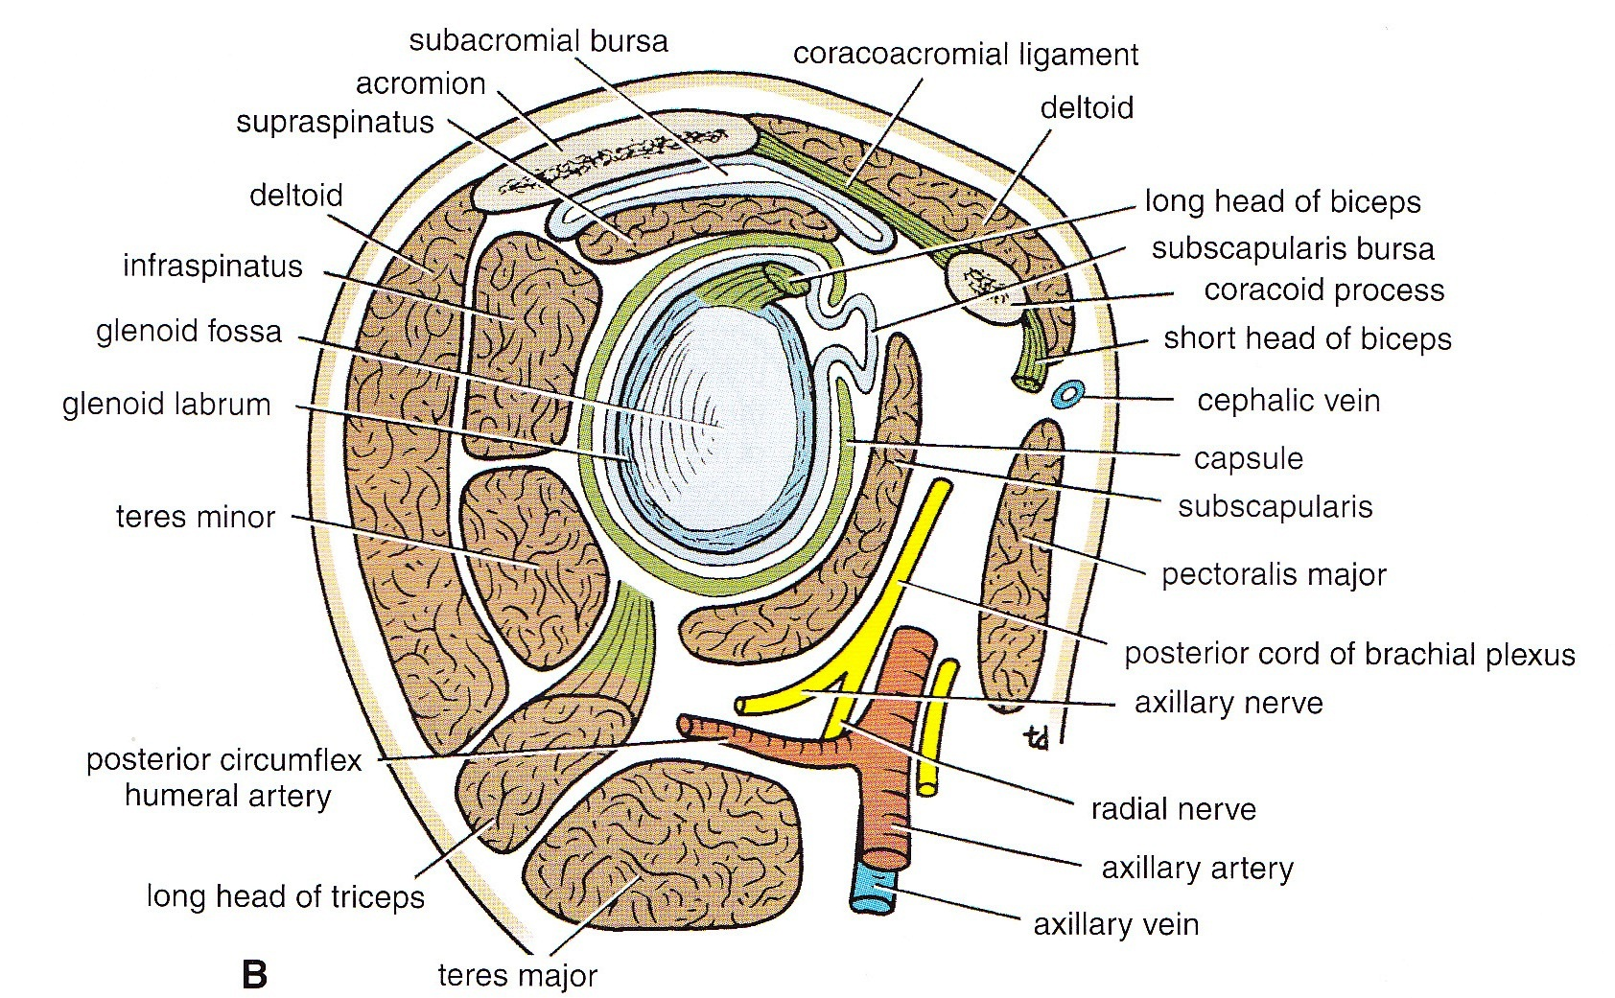

Slide 18
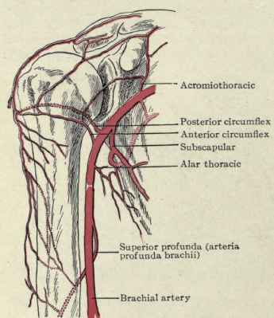
Blood Supply
Anterior circumflex humeral artery
Posterior circumflex humeral artery
Suprascapular artery
Subscapular artery

Slide 19
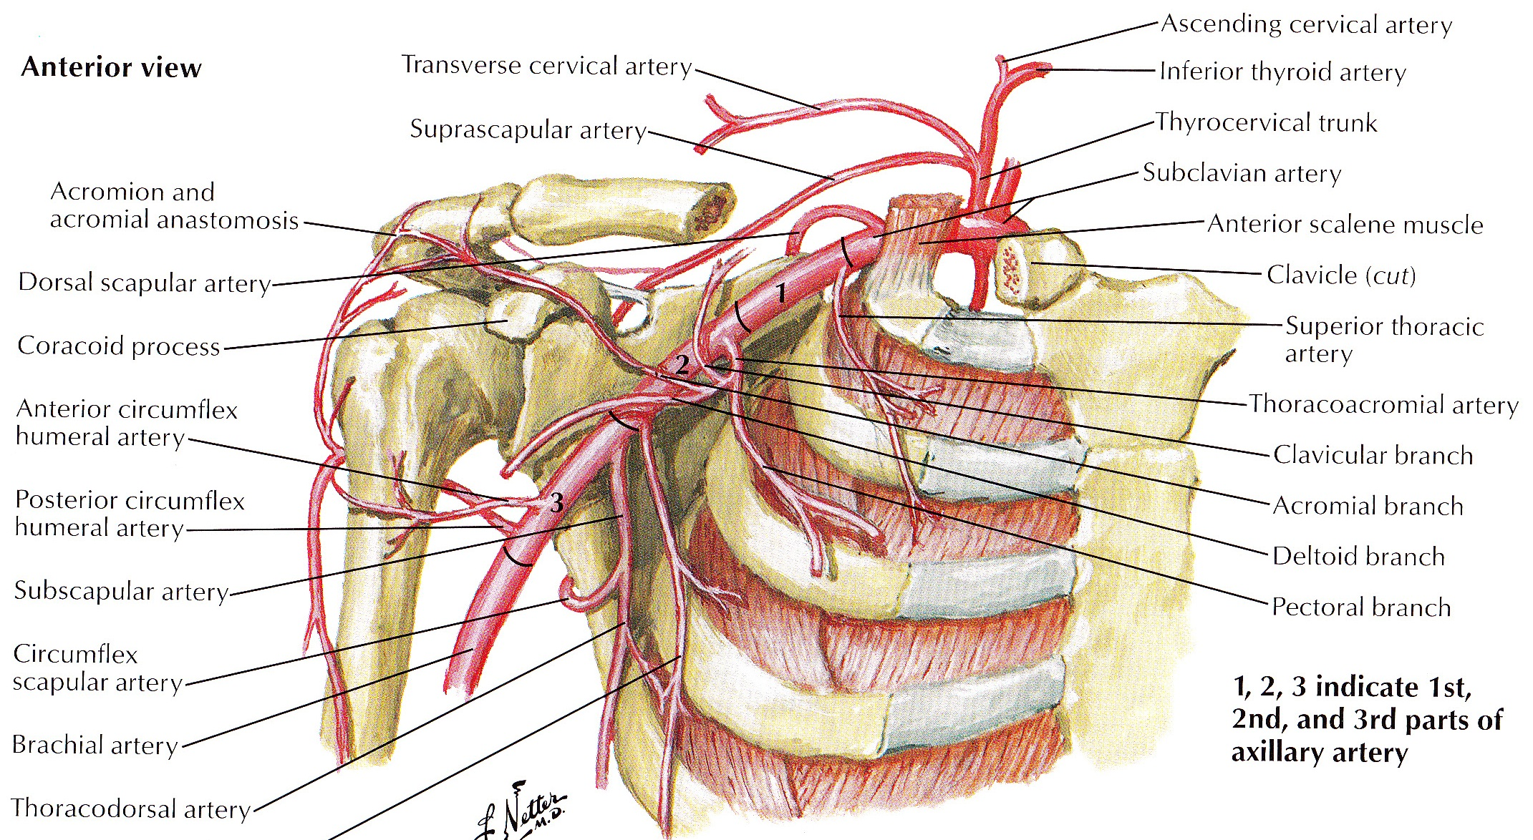
Blood Supply

Slide 20
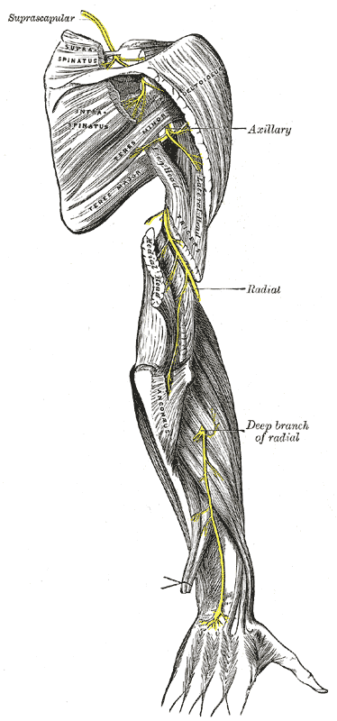
Nerve Supply
Axillary nerve
Suprascapular nerve
Musculocutaneous nerve

Slide 22
Relations
Superiorly
Supraspinatus m.
Subacromial bursa
Coracoacromial ligament
Deltoid m.
Inferiorly
Long head triceps brachii m.
Axillary nerve
Post. circumflex humeral vessels
Anteriorly
Subscapularis m.
Coracobrachialis
Short head of biceps brachii
Deltoid
Posteriorly
Infraspinatus
Teres minor
Deltoid
Within the joint
- Tendons of long head biceps brachii

Slide 23
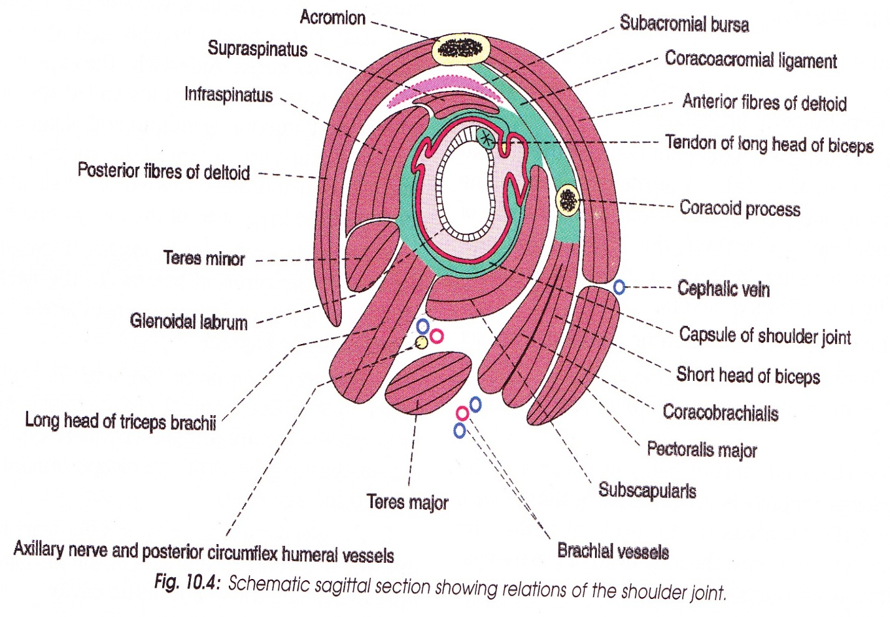

Slide 24
Movements

Slide 25
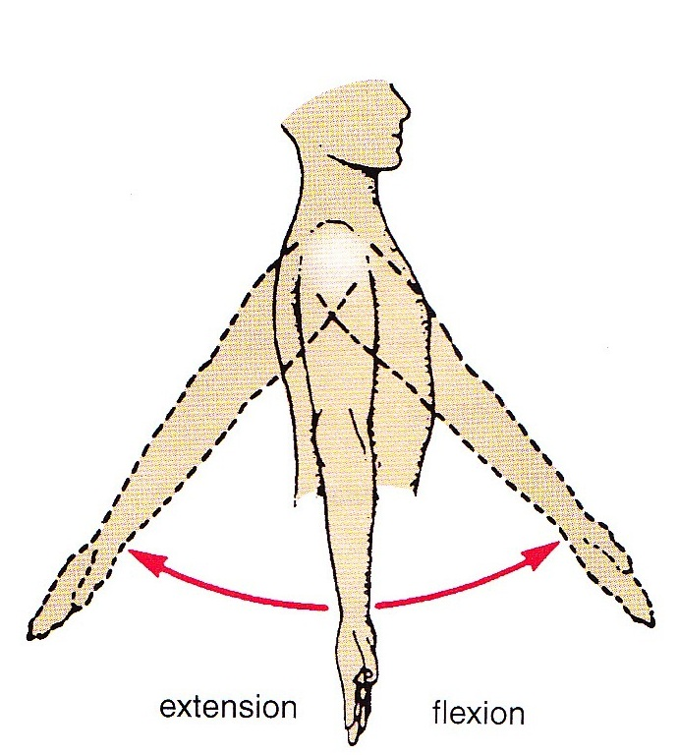
Flexion & Extension
Flexion – Arm moves forwards & medially.
Extension – Arm moves backwards & laterally.
MOVEMENT
MAIN
ACCESSORY

Slide 26
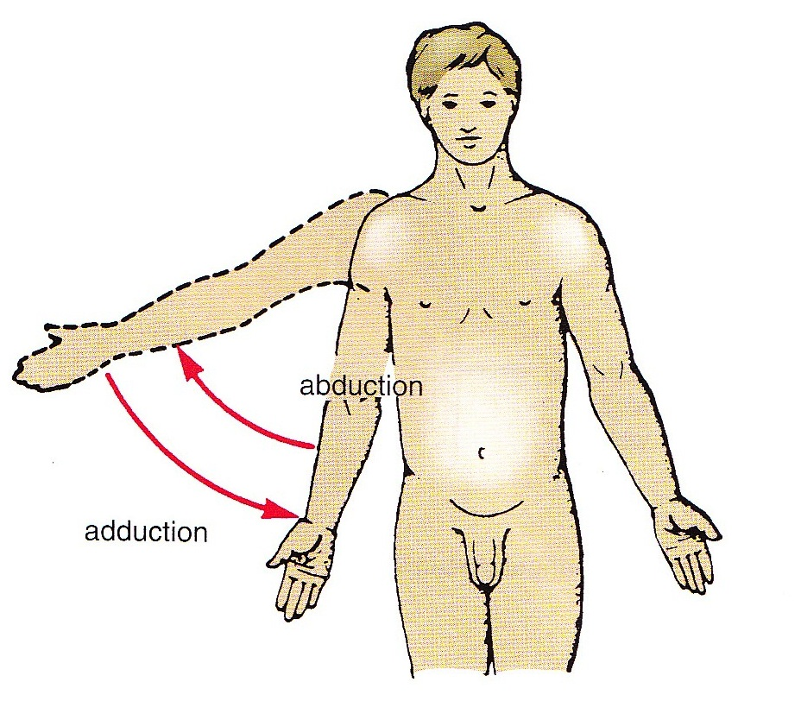
Abduction & Adduction
Abduction – Arm moves away from trunk.
Adduction – Arm moves towards the trunk.
MOVEMENT
MAIN
ACCESSORY

Slide 27
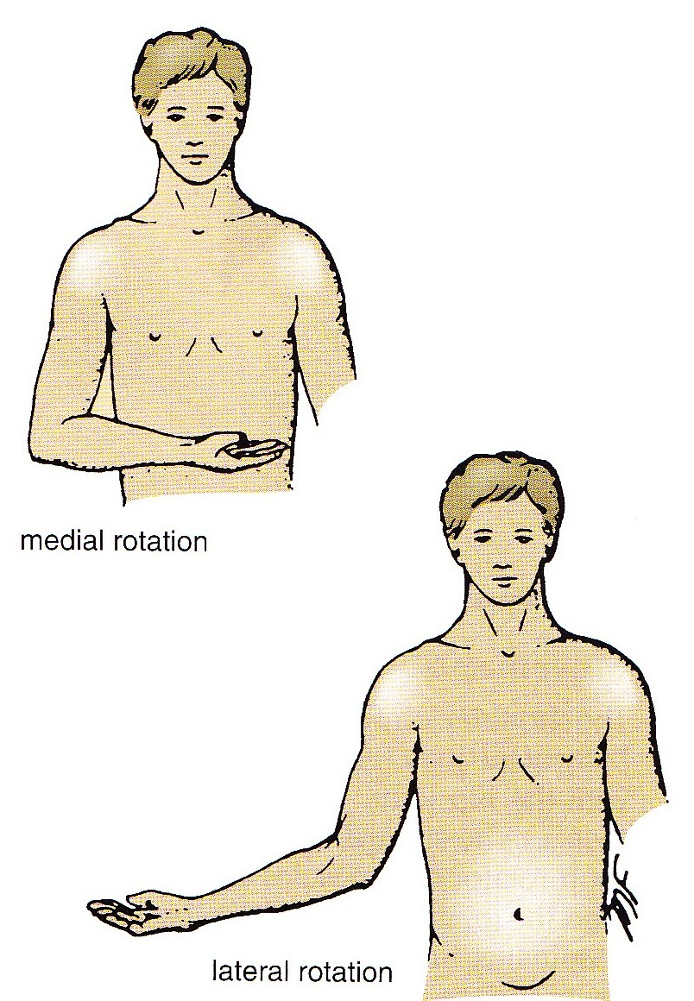
Medial & Lateral Rotation
Medial rotation – Hand moves medially.
Lateral rotation – Hand moves laterally.
MOVEMENT
MAIN
ACCESSORY

Slide 28
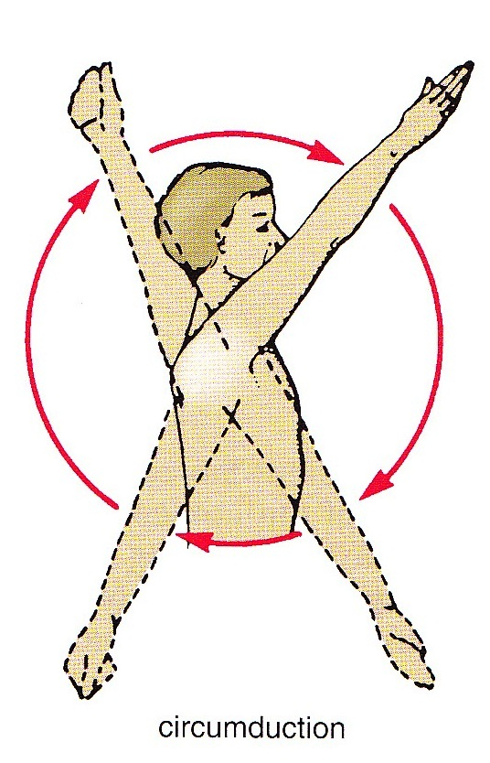
Circumduction
Combination of dif. movements, results in hand moving along a circle.

Slide 29
Factors providing stability to joint
Rotator cuff-
capsule of the joint is strengthened by slips of tendons of subscapularis m., supraspinatus m., infraspinatus m. & teres minor (rotator cuff muscles).
Tone of muscles grasp head of humerus and pull it medially to hold it against shallow glenoid cavity.

Slide 31
Factors providing stability to joint(contd.)
Coracoacromial arch.
Long head of biceps tendon.
Glenoid labrum.

Slide 32
Applied Anatomy
Dislocation of shoulder joint
-mostly occurs inferiorly.
-axillary nerve injured due to close proximity.
-clinically described as – anterior and posterior dislocation.
-caused by excessive extension and lateral rotation of humerus.
-presents as hollow in rounded contour of shoulder and prominent tip.

Slide 33
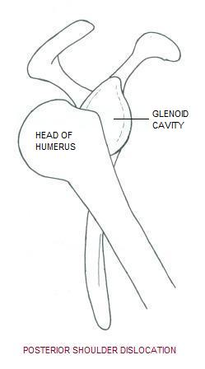
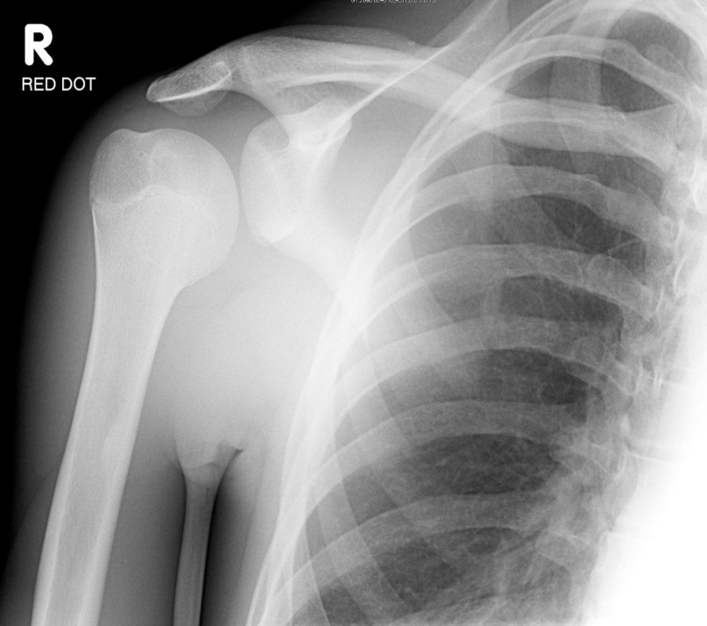

Slide 34
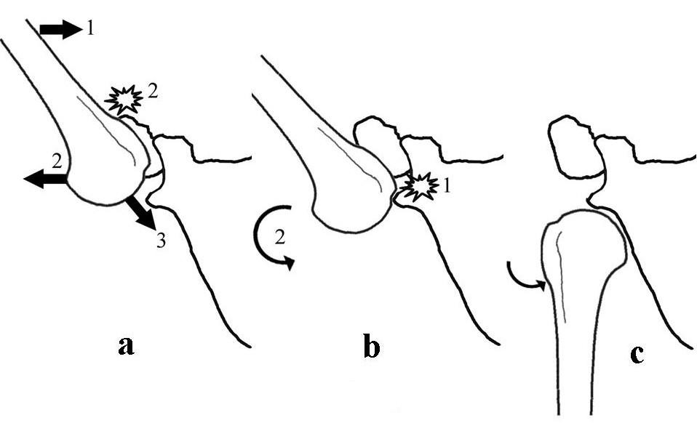
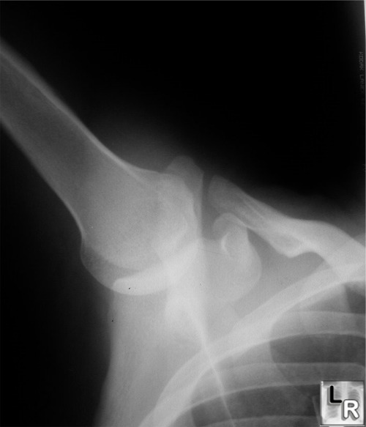
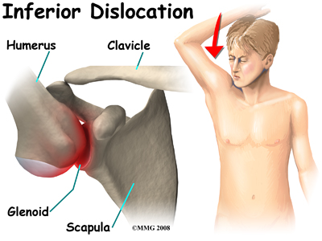

Slide 35
Frozen shoulder ( Adhesive capsulitis)
- pain and uniform limitation of all movements of the joint.
-no radiological changes.
-due to shrinkage of joint capsule.
• Rotator cuff disorders
- calcific supraspinatus tendinitis.
- subacromial bursitis.
- painful arc syndrome.

Slide 36
Thank You!

